Slide 1

Object-Oriented Software Engineering
TTTE6104
Software Engineering Paradigm

Slide 2
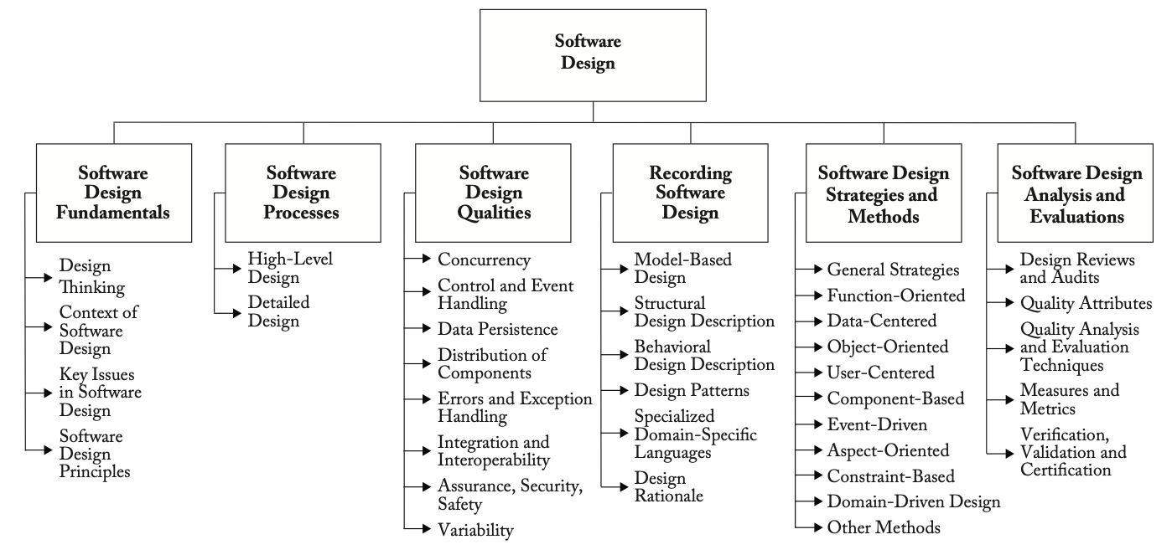

Slide 3
Introduction
Definition of OOSE
  A systematic approach to software development that incorporates object-oriented principles, methodologies, and techniques to design and implement software systems.
Importance of OOSE in software development
  Focuses on modeling real-world entities as "objects," which encapsulate both data (attributes) and behavior (methods) related to those entities

Slide 4
Key Components of OOSE
Object-Oriented Principles
  Encapsulation: Bundling data and methods that operate on that data within a single unit (the object), promoting data hiding and abstraction.
  Inheritance: Allowing a new class to inherit properties and behaviors from an existing class, facilitating reusability and the creation of hierarchical relationships.
  Polymorphism: Enabling objects to be treated as instances of their parent class, allowing for method overriding and overloading, which enhances flexibility in code execution.
Modeling Real-World Systems
  OOSE uses models to represent real-world entities and their interactions. These models help in understanding and specifying the requirements of the software system.

Slide 5
Key Components of OOSE
Software Development Life Cycle
  OOSE integrates the principles of OOP throughout all phases of the SDLC, including requirements gathering, analysis, design, implementation, testing, and maintenance, ensuring a cohesive approach to software development.
Unified Modeling Language (UML)
  OOSE often employs UML as a standardized modeling language to visualize the design of a system, facilitating communication among stakeholders.
Focus on Reusability and Maintainability
  By emphasizing modular design and the use of classes and objects, OOSE promotes code reusability and simplifies maintenance, which are crucial for long-term software sustainability.

Slide 6
Software Development Life Cycle (SDLC)
Requirement Analysis
System Design
Implementation
Testing
Deployment
Maintenance
Role of OOSE in each phase

Slide 7
Object-Oriented Analysis and Design (OOAD)
A way to design software by thinking of everything as objects similar to real-life things
Two distinct but closely related processes: Object-Oriented Analysis (OOA) and Object-Oriented Design (OOD)

Slide 8
Important Aspects of OOAD
Object-Oriented Programming: In this the real-world items are represented/mapped as software objects with attributes and methods that relate to their actions.
Design Patterns: Design patterns are used by OOAD to help developers in building software systems that are more efficient and maintainable.
UML Diagrams: UML diagrams are used in OOAD to represent the different components and interactions of a software system.
Use Cases: OOAD uses use cases to help developers understand the requirements of a system and to design software systems that meet those requirements.

Slide 9
Benefits of Object-Oriented Analysis and Design (OOAD)
It increases the modularity and maintainability of software by encouraging the creation of tiny, reusable parts that can be combined to create more complex systems.
It provides a high-level, abstract representation of a software system, making understanding and maintenance easier.
It promotes object-oriented design principles and the reuse of objects, which lowers the amount of code that must be produced and raises the quality of the program.
Software engineers can use the same language and method that OOAD provides to communicate and work together more successfully in groups.
It can assist developers in creating scalable software systems that can adapt to changing user needs and business demands over time.

Slide 10
Real world applications of OOAD
Banking Software
Electronic Health Record (EHR) Systems
Flight Control Systems
Telecom Billing Systems
Online Shopping Platforms

Slide 11
Class Activity
Work in teams to identify a real-world application of Object-Oriented Analysis and Design, analyze its components, and present the findings.
Each team will select a real-world example of a software application that utilizes Object-Oriented Analysis and Design principles.
Suggested sources - Academic Articles, Whitepapers, Case Studies, Open Source Projects (GitHub)

Slide 12
Each team will analyze their selected application and gather the following information:
Project Title: Name of the application or system.
Overview: Brief description of the application and its purpose.
Diagrams: Create and include relevant UML diagrams such as:
  Use Case Diagram
  Class Diagram
  Sequence Diagram
Tools Used: Identify the tools and technologies used in the development of the application (e.g., programming languages, frameworks, design tools).
Benefits of Using OO Approach: Discuss the advantages of using an object-oriented approach in their chosen example, including aspects like modularity, maintainability, scalability, and ease of collaboration.

